Slide 1

Survivorship and Living with Metastatic Illness: How do they relate?
Bay Area Cancer Connections
November 3, 2023

Slide 2
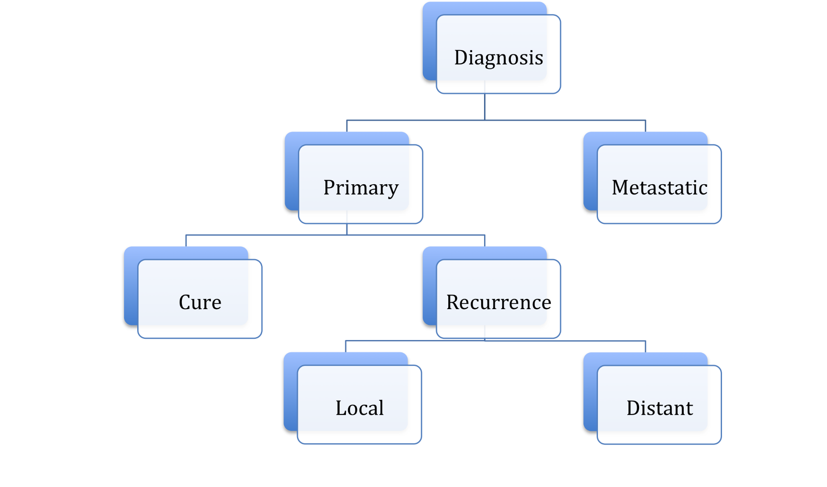
Nomenclature
SURVIVORSHIP
Notes:
Note: Clicking on the picture above will lead to website that contains Guest Services Video.
Upon clicking, user will be prompted for password. Password is: GuestServices

Slide 3
Recurrence versus Progression
“I had cancer” | Being told you have cancer Worry whether treatment has worked Fear of cancer still there or it will come back
“I have cancer” | Being told you have cancer Worry whether treatment has worked Fear of cancer spreading
Notes:
Note: Clicking on the picture above will lead to website that contains Guest Services Video.
Upon clicking, user will be prompted for password. Password is: GuestServices

Slide 4
Exercise
  My biggest fear is….
Notes:
Note: Clicking on the picture above will lead to website that contains Guest Services Video.
Upon clicking, user will be prompted for password. Password is: GuestServices

Slide 5
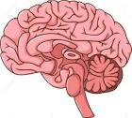



Processing and (Mis)Interpretation
Based on biology
Based on biased conditioned cognition, e.g.
-Family
-Society
-Religion
Based on fear misinterpretation
Outside feed
Inside feed

Slide 6
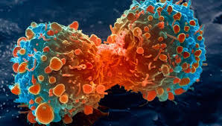


The Fear Brain Design Flaw
“The cancer might grow”
Notes:
Note: Clicking on the picture above will lead to website that contains Guest Services Video.
Upon clicking, user will be prompted for password. Password is: GuestServices

Slide 7


“Arousal”
Internal Stimulation
External Stimulation
Time (h/d)

Slide 8






Internal Stimulation
External Stimulation
“Arousal”
Time (h/d)

Slide 9


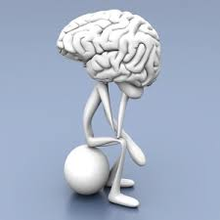




It is not (only) the things themselves that disturb men (people), but (also) their beliefs about these things
Epictetus/Kogon
THOUGHTS
EMOTIONS
The cancer will come back
The cancer will kill me
I need to rest
I can’t get out of bed
I cannot lose my job
Who is supporting me?
Sad
Angry
Happy
Fearful
Content
Frustrated
BODY
Palpitations
Queasy
Chest tightness
Headache
Malaise
Exhausted
Fatigued
Energetic
Foggy
Muscle tension

Slide 10
The Cognition Design Flaw
  The brain is a fact tracker and a storyteller
Notes:
Note: Clicking on the picture above will lead to website that contains Guest Services Video.
Upon clicking, user will be prompted for password. Password is: GuestServices

Slide 11
Conundrum
  Living with Uncertainty
  “I DON’T KNOW”
Notes:
Note: Clicking on the picture above will lead to website that contains Guest Services Video.
Upon clicking, user will be prompted for password. Password is: GuestServices

Slide 12
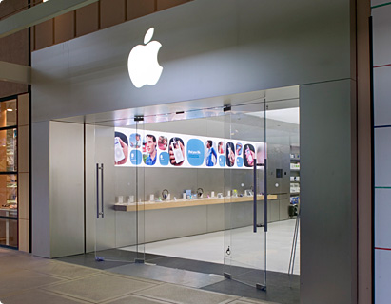
Uncertainty
It will happen
It will not happen
REALITY
It could happen
Notes:
Note: Clicking on the picture above will lead to website that contains Guest Services Video.
Upon clicking, user will be prompted for password. Password is: GuestServices

Slide 13
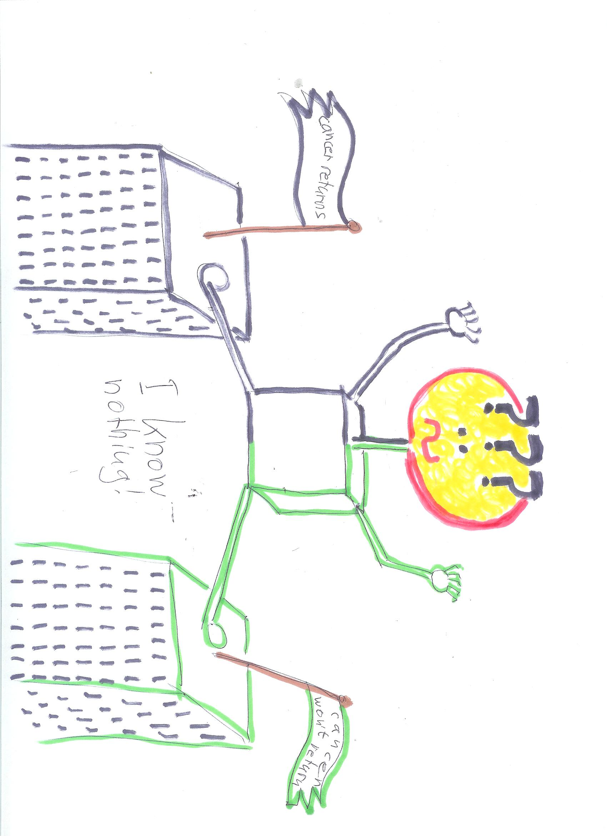

Slide 14
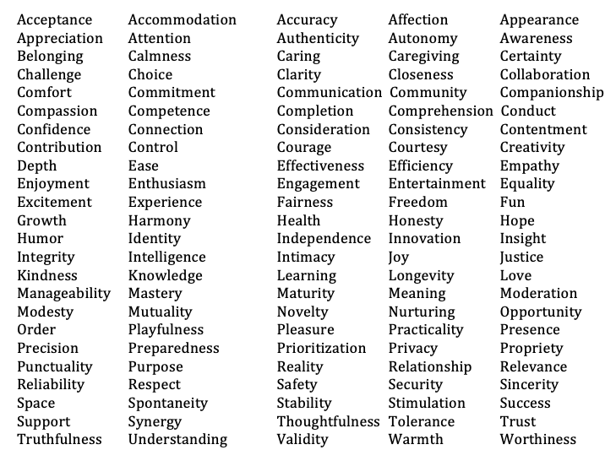
I would love some more………
Notes:
Note: Clicking on the picture above will lead to website that contains Guest Services Video.
Upon clicking, user will be prompted for password. Password is: GuestServices

Slide 15
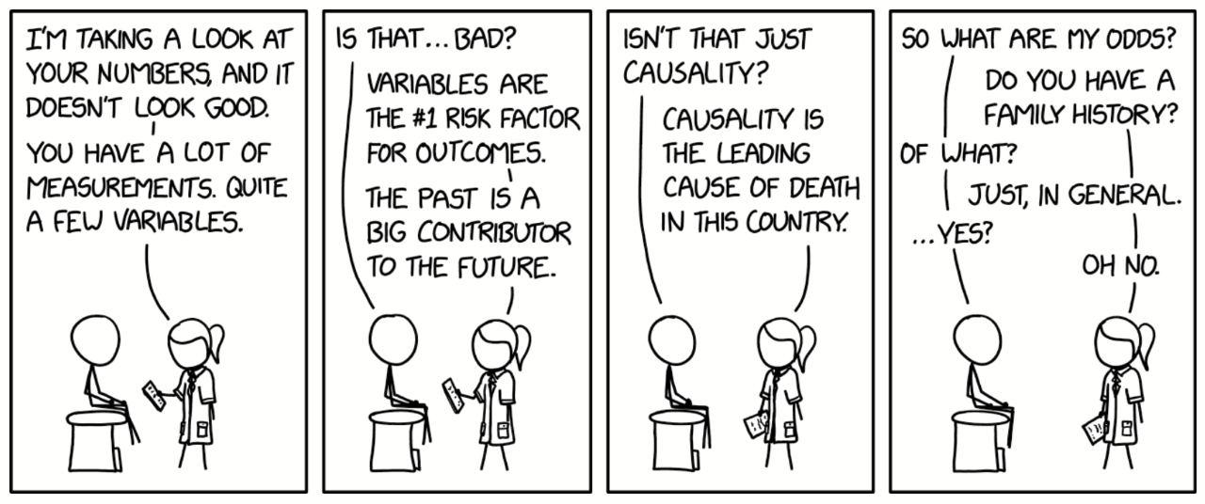
Comprehension and Causality
Notes:
Note: Clicking on the picture above will lead to website that contains Guest Services Video.
Upon clicking, user will be prompted for password. Password is: GuestServices

Slide 16
Support
Shift to care receiver during illness
Caregiver identity before illness
Care receiver
Caregiver
Notes:
Figure 20

Slide 17
Need for CAREGIVING
Not feasible to fulfill
Fulfill different need
Do something else
Fulfill
Happy!
Fulfill need in a different way
Body
Emotion
Thought
Notes:
Figure 20 straight line crossout, CAVE error Mind instead of thought corrected to Thought and changed order

Slide 18
Competence
Actual performance after cancer
Perceived performance after cancer
Actual/perceived performance before cancer
Low cognitive performance
High cognitive performance
Notes:
Figure 20

Slide 19
Closeness
Partner’s need for closeness after illness
Partner’s need for closeness after illness
Patient’s need for closeness before illness
Patient’s need for closeness after illness
Low need for closeness
High need for closeness
Notes:
Figure 20

Slide 20
